Slide 1

Real-Time High Quality Rendering
Bowen Du, Sichuan University
Fluid Simulation

Slide 2
TODAY
Introduction
The principles behind fluid simulation
Demo
Fluid simulation for games

Slide 3

Introduction
Water. It’s one of the most important resources on Earth yet one we often take for granted. Not in video games though! Every time there’s a gorgeous body of water, we can’t help but stop and be amazed

Slide 4

Introduction
Crysis 3
Release year: 2013

Slide 5

Introduction
Assassin's Creed Origins
Release year: 2017

Slide 6
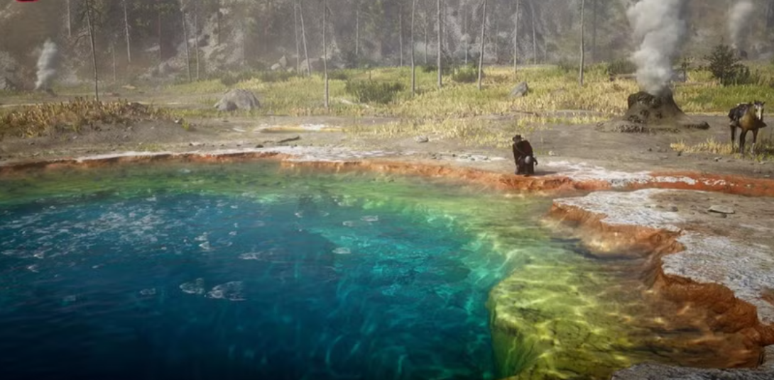
Introduction
Red Dead Redemption 2
Release year: 2018

Slide 7

Introduction
Sea Of Thieves
Release year: 2018

Slide 8
TODAY
Introduction
The principles behind fluid simulation
Demo
Fluid simulation for games

Slide 9
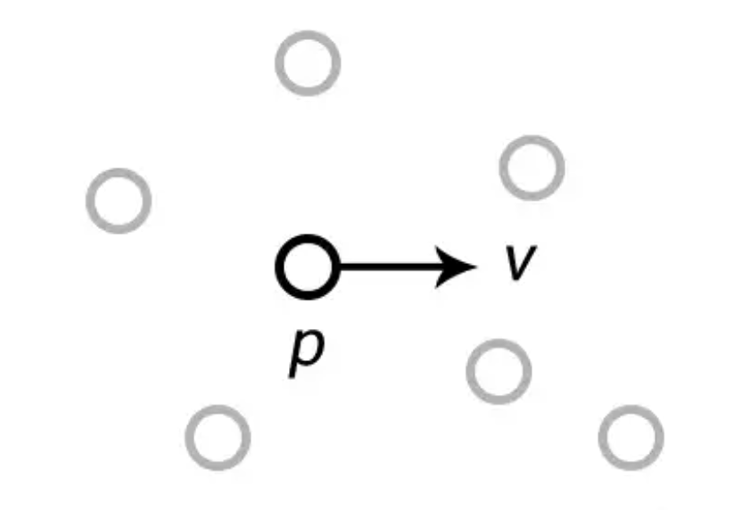
Lagrangian Specification&&Eulerian Specification
In the Lagrangian perspective, fluids are represented as particles that carry sufficient physical information, with each frame simulating their movement and interactions to predict their behavior in the next frame.

Slide 10
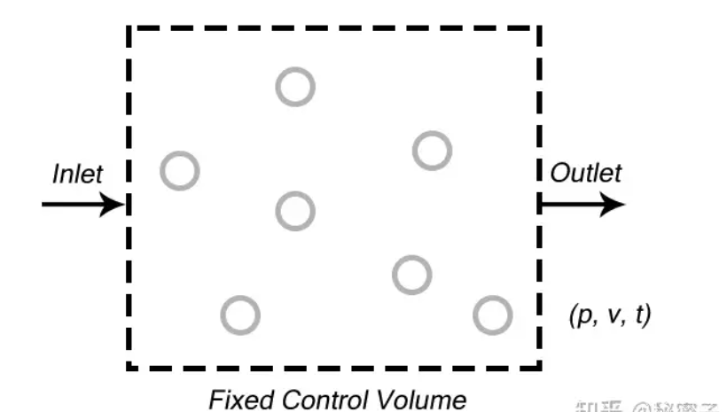
Lagrangian Specification&&Eulerian Specification
In the Eulerian perspective, fluids are analyzed by dividing the container into fixed spaces, focusing on changes in physical quantities within these regions to compute fluid behavior in the next frame.

Slide 11
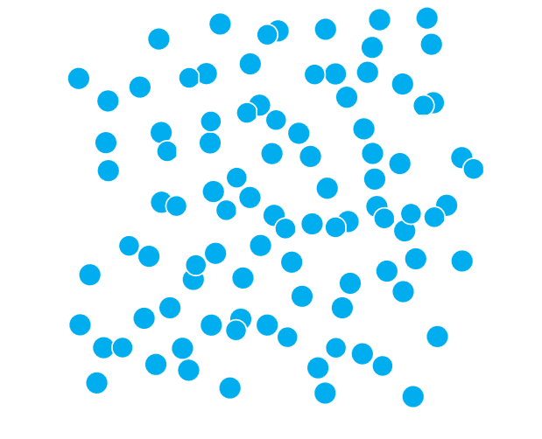

Continuum Simulation
Lagrangian representation
Eulerian representation

Slide 12
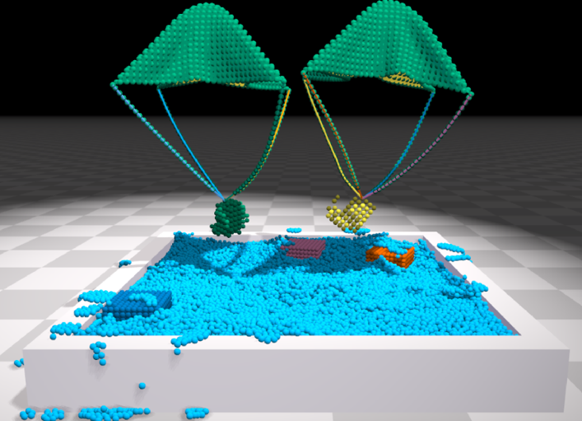
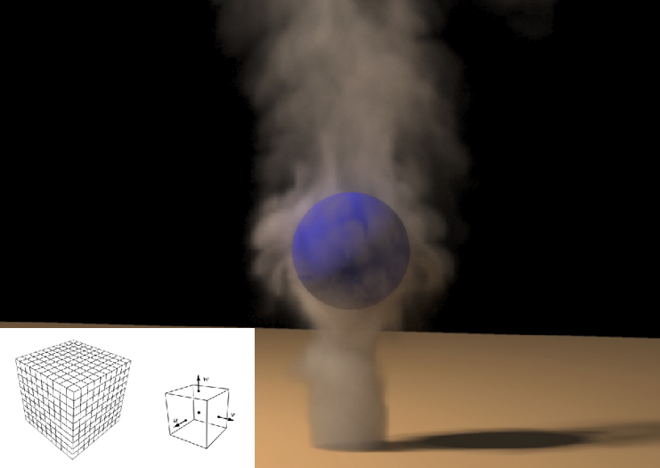
Continuum Simulation
Lagrangian representation
[Macklin et al. 2014,
Unified Particle Physics for Real-Time Applications]
Eulerian representation
[Fedkiw 2001, Visual Simulation of Smoke]

Slide 13
How to Address Computational Challenges in Real-Time Fluid Simulation?
SPH
PBF

Slide 14
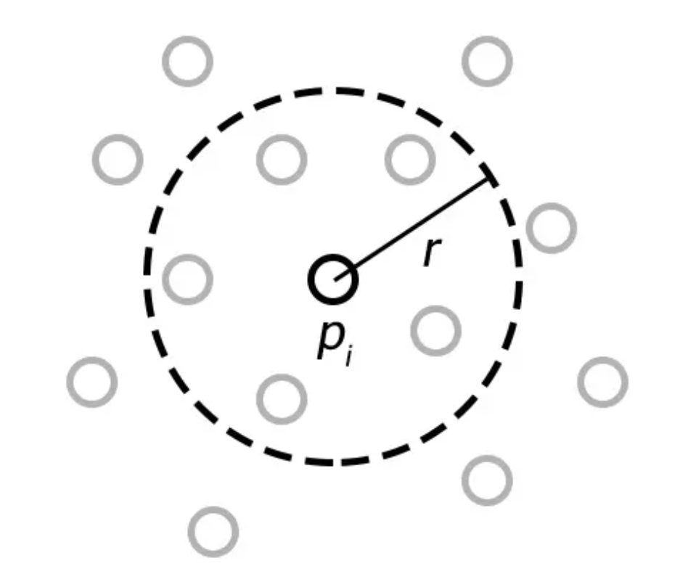
SPH
SPH (Smoothed Particle Hydrodynamics) is a fluid simulation method where particles interact with neighbors within a radius to compute physical properties like density and pressure, then determine forces, velocities, and positions for each frame.

Slide 15
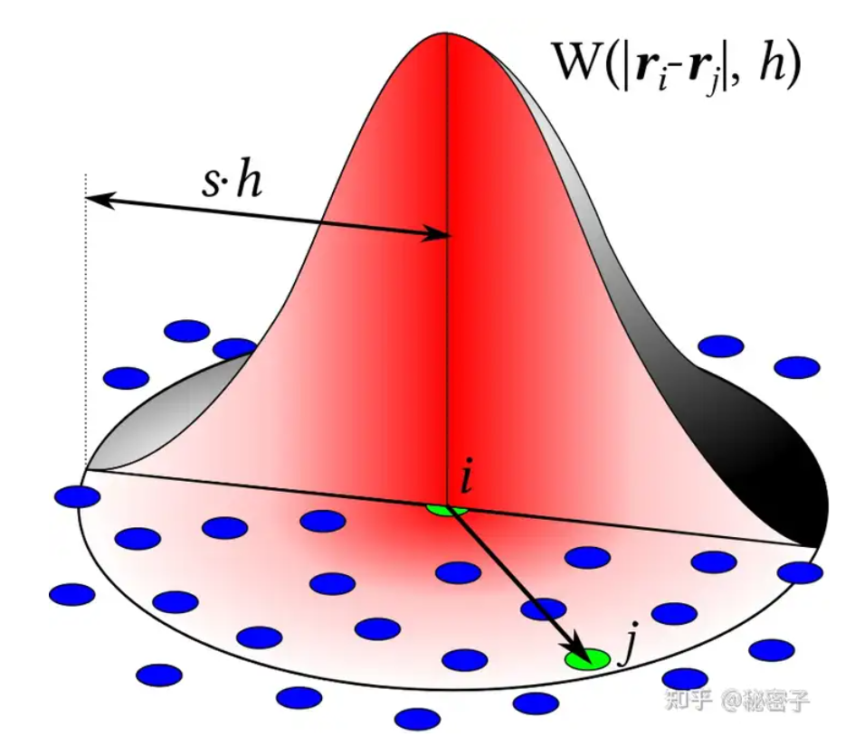
SPH
One of the key aspects of SPH is the "Kernel Function," which assigns higher contributions to particles closer to the current particle, typically following a Gaussian-like distribution where the influence decreases as distance increases.

Slide 16
SPH Process
For each particle, find its neighbors .
Calculate the density and pressure
Compute various forces
update the particle's velocity and position

Slide 17
SPH CONS
High Temporal Resolution Requirement
requires a fine temporal resolution, meaning that users cannot simulate SPH physics with large time intervals
Low Robustness
calculates forces rather than the relative positions of particles, which makes the system less robust

Slide 18
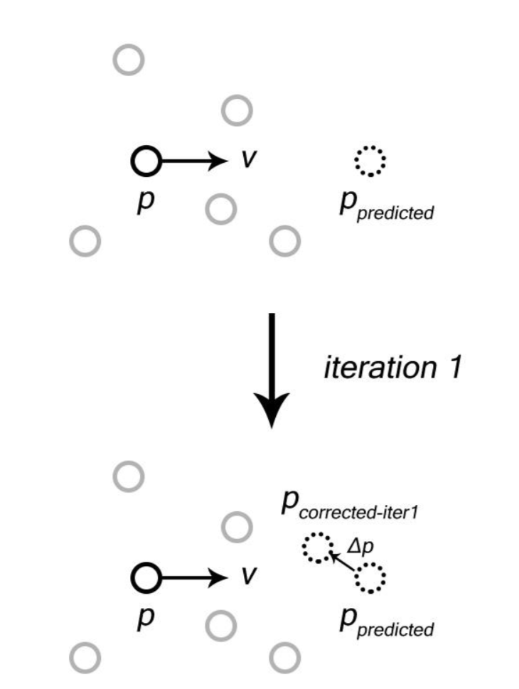
PBF
The core idea of the PBF (Position Based Fluids) method is to predict where particles will move based on their initial velocities and then iteratively adjust their positions using a solver to reach a stable state. It still follows the SPH approach by finding neighboring particles to compute their physical properties.
M. Macklin and M. Matthias, "Position Based Fluids," ACM Transactions on Graphics, vol. 32, no. 4, pp. 1-12, 2013.

Slide 19
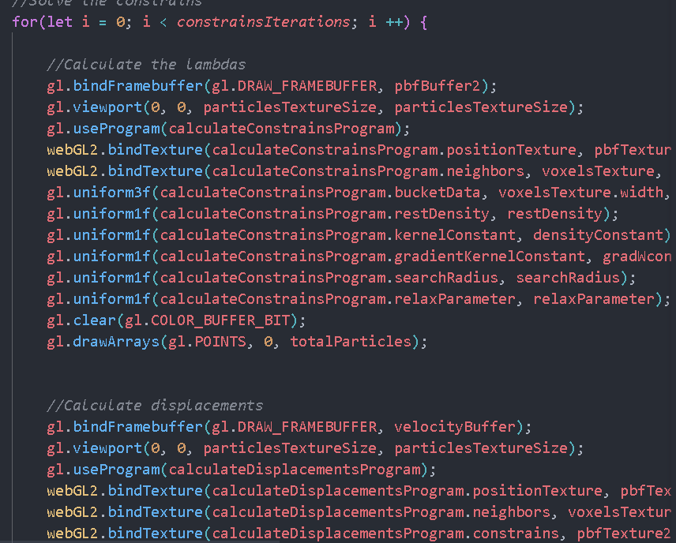
PBF
Process
update its velocity based on external forces to predict its position in the current frame and find its neighboring particles
Iterate multiple times to refine the particle positions.
recalculate the new velocity for each particle

Slide 20
Optimaztion
Neighborhood Search
O(n^2)
BVH
BitBuckets
Hash functions
Buffers

Slide 21
How to Render Particles to Appear as a Unified Body of Water?
Rendering particle-based fluids is difficult
Simulation doesn’t naturally generate a surface (no grid, no level set) Just get particle positions and density
Traditionally, rendering done using marching cubes
Generate Density Field from Particles
Extract Polygon Mesh Isosurface
Can Be Done on GPU, but Very Expensive

Slide 22
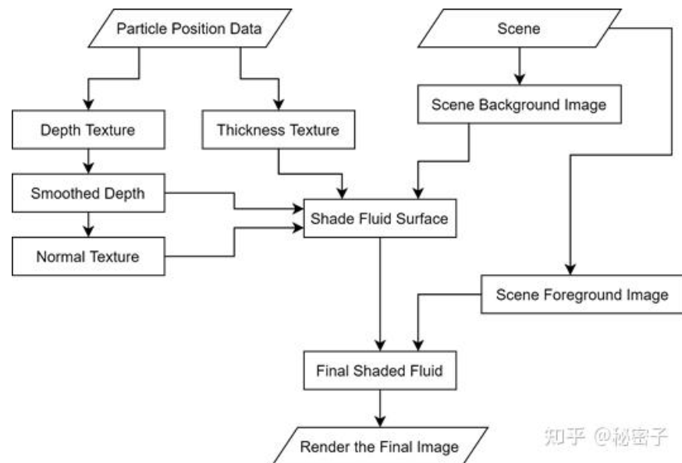
Screen Space Fluid Rendering
Render particles as spheres in screen space to generate depth and thickness maps.
Smooth the depth map and then calculate the fluid's normal map.
Use the normals to calculate lighting and shade the fluid accordingly.
se the thickness map to adjust shading and blend the fluid with the environment.

Slide 23
TODAY
Introduction
The principles behind fluid simulation
Demo
Fluid simulation for games

Slide 24
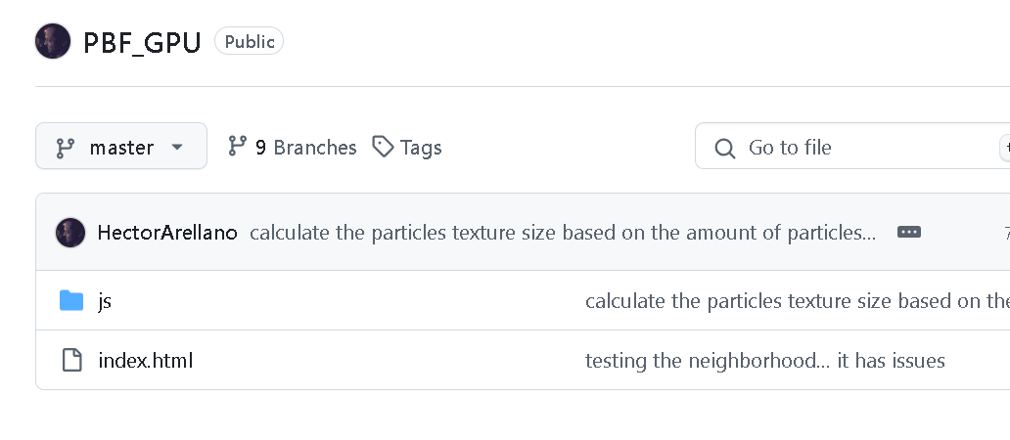
https://github.com/HectorArellano/PBF_GPU.git

Slide 25
TODAY
Introduction
The principles behind fluid simulation
Demo
Fluid simulation for games

Slide 26


Justice Online

Slide 27
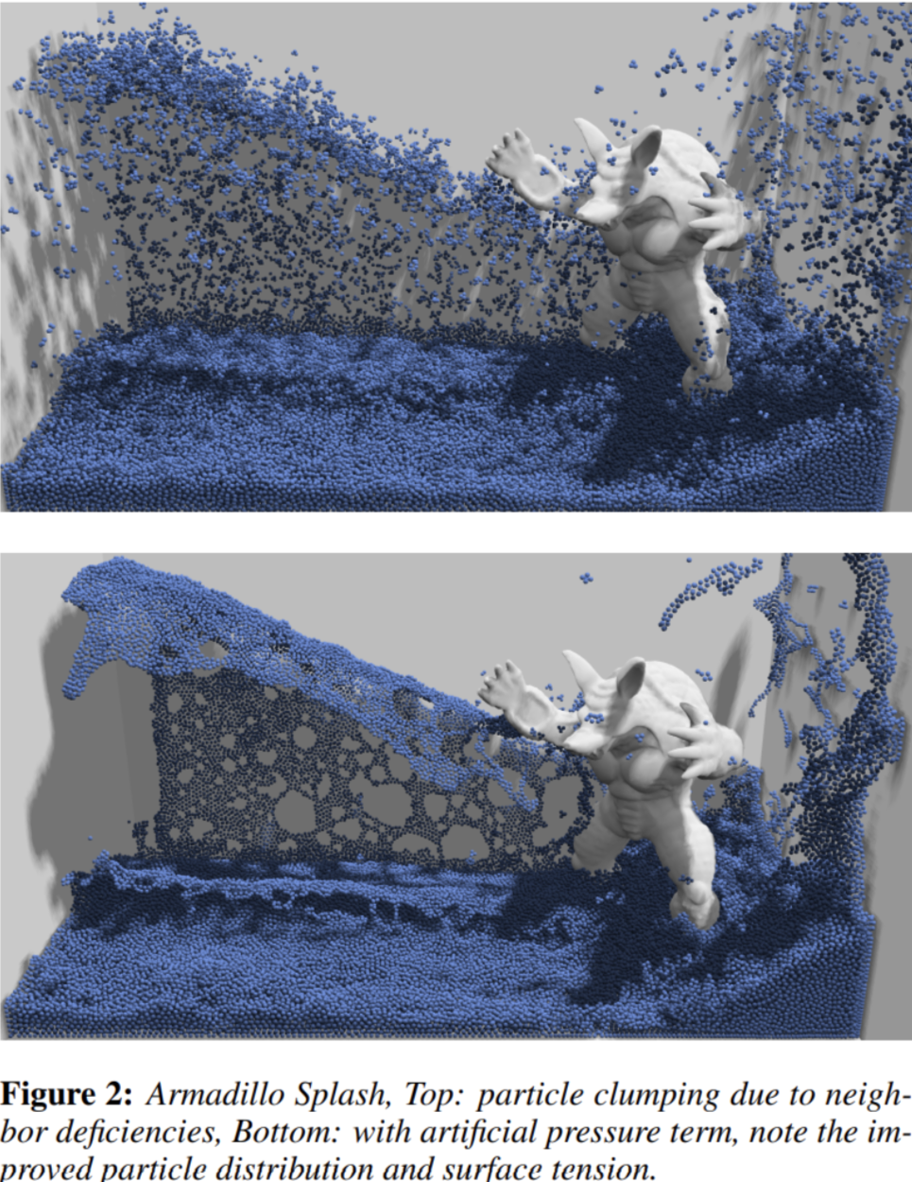
Problems
To address these two anomalous phenomena, introduce a viscosity term.
particle clumping

Slide 28
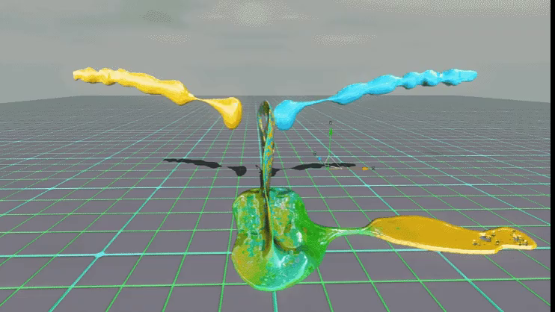
Effect
Self-mixing of fluid colors

Slide 29
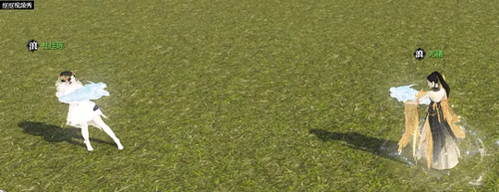
Effect
Particle emission and recycling

Slide 30
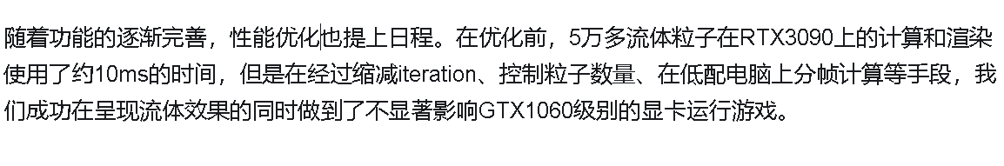
Summary
Fluid is composed of several SPH particles, and incompressibility is maintained through iterative solving of particle distance constraints and fluid density constraints proposed in Position Based Fluids (SIGGRAPH 2013).
Other physical interaction effects, including efficient fluid-scene collisions and fluid-character collisions, are also achieved through constraint solving on particle positions.
The deferred rendering technique is used to directly render fluid particles as screen-space depth and normals, eliminating the overhead of mesh generation, while various smoothing techniques ensure the fluid surface is both smooth and detailed.

Slide 31
Questions?

Slide 32
Thank you!

